Slide 1
Visions: The Evolution of Ticketing - Providing More Options for Fans & Patrons

Slide 2
MODERATORS
Alan Pandiani, Paciolan
PRESENTERS
Bryan Derbyshire, Protecht
David Simpson, The Fox Theatre
Michael Solomon, Texas A&M University
Rob Clark, San Jose State University

Slide 3
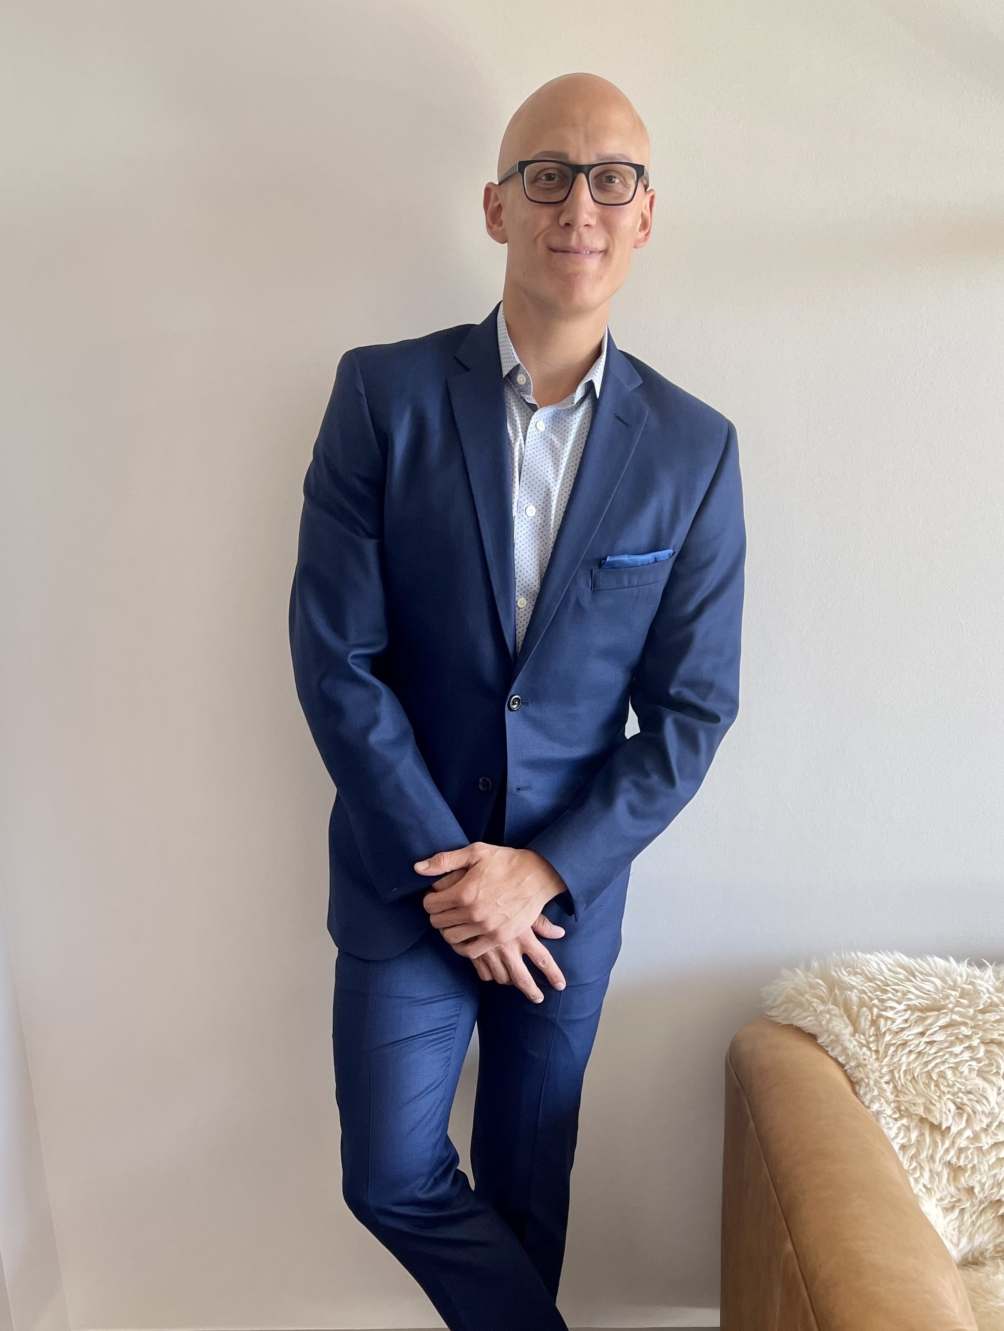
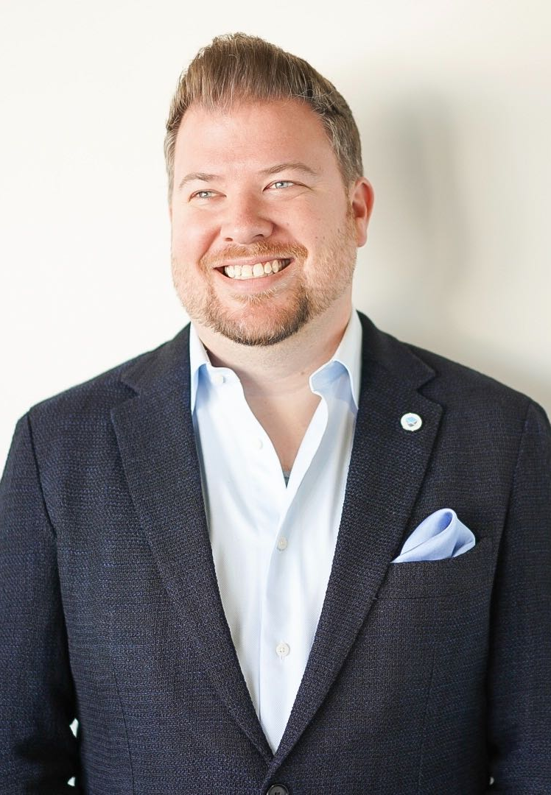
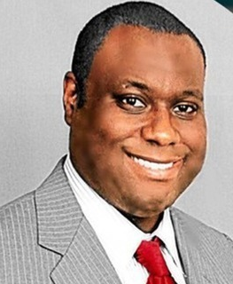
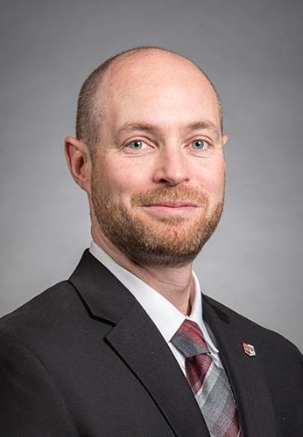
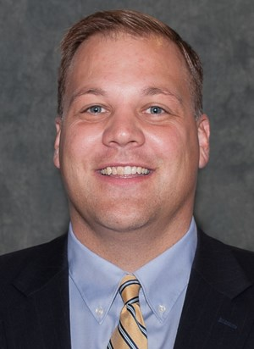
Alan Pandiani
Bryan Derbyshire
David Simpson
Michael Solomon
Rob Clark
Paciolan
Protecht
The Fox Theatre
Texas A&M University
San Jose State University

Slide 4
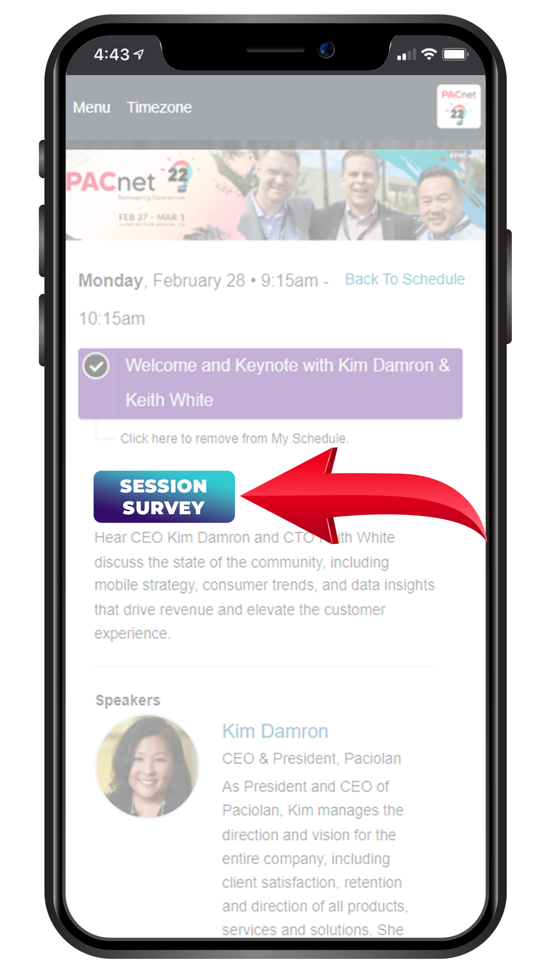
THANK YOU!
QUESTIONS?
Please complete the online session evaluation.

